Slide 1
Becoming Data Native How BIBFRAME Extensibility Delivers Libraries A Path to Scalable, Revolutionary Evolution
Eric Miller, President and CEO
Zepheira and The Library.Link Network

Slide 2
Core Tenants and Themes of BIBFRAME
Extensible
Purposeful
Collaborative
Connected
Accessible
Contemporary

Slide 3
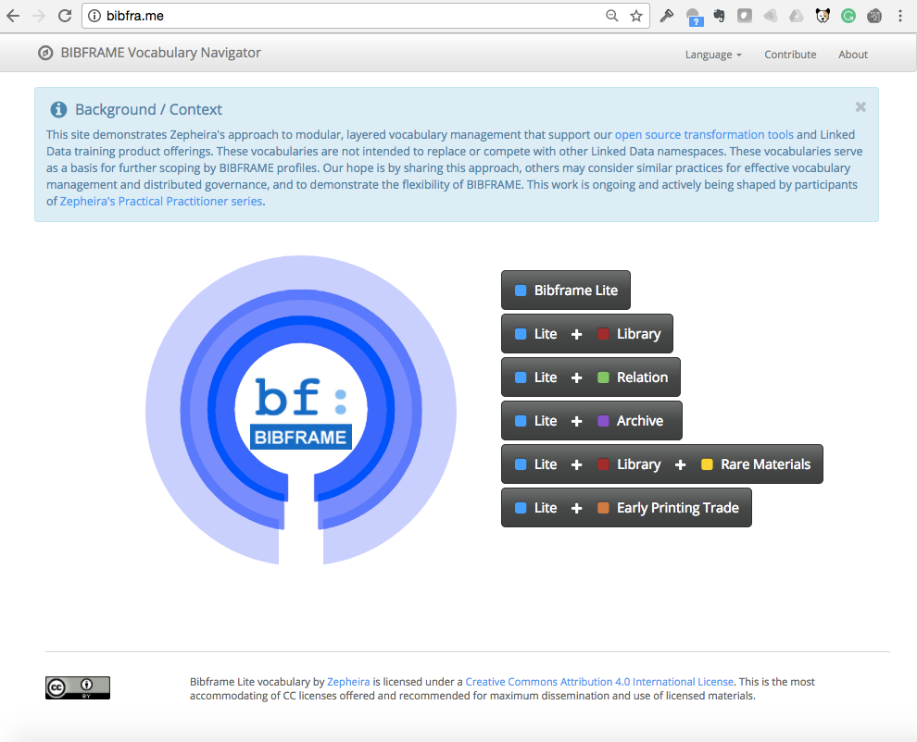
1. Extensible
Contemporary RDF foundation
Constant state of evolution
Community vocabulary MARC & much more
Archives & Rare Materials
Libraries, Locations
Serivces, Events

Slide 4
2. Purposeful Use Linked Data with Intent
Manage
Transform
Need
Measure
Find
Use

Slide 5
Linked Data and the Library.Link Network bringing library data to life
Connect with communities
On the Web
Through Outreach
Via existing Web & Discovery Environments
Gain insights from your data
Content, connections, and community

Slide 6
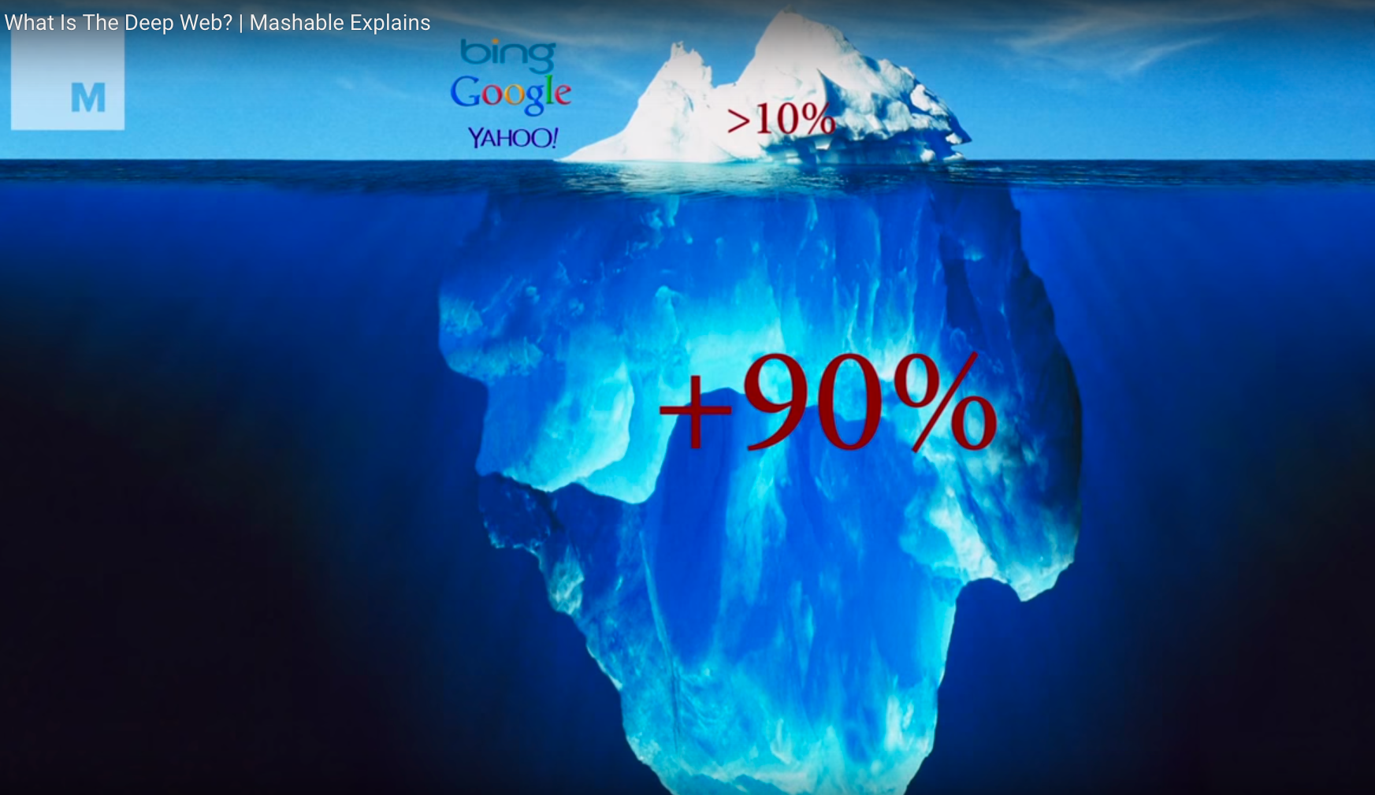
Wikipedia = 20-50 Gig
Library.Link Network=
1200+ Library Systems
2500+ Physical Locations
100,000+ Gig/ 100+ TB Connected Data

Slide 7
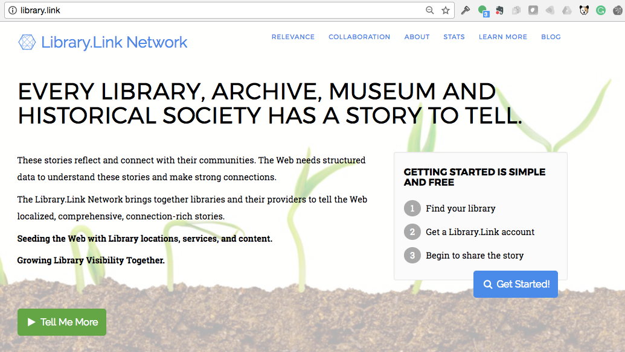
3. Collaborative and Comprehensive Library.Link Network Solutions (http://library.link)
Catalog Publishing
Innovative Linked Data
SirsiDynix BLUEcloud Visibility
EBSCO Linked Library Service
Data Enrichment
NoveList Select for Linked Data
Resource Sharing Publishing
Innovative Linked Data (INNReach group publishing)
Archives and Special Collections Publishing
Atlas Web Visibility Service

Slide 8
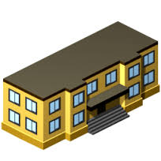
4. Connected
Academic Libraries
Museums, and Archives
Helping libraries become “data native”
Telling individual and shared stories
Connecting via the Network
Public
Libraries
Publishers and
Authorities
Web
Connections

Slide 9
Transform

Slide 10
Linked Data is about connections and transforming the way data works
BF Resource Type
Work Type
Instance Type
1. Source
Data & Context
2. Conversion
3. Reconciliation
4. Network Connection
5. Web
Connections
ItemType
Transformation
Albert Einstein
Albert Einstein
Walter Isaacson
Theoretical Physics
245: The Principle of Relativity
100:
Albert Einstein
6xx:
Theoretical Physics
Albert Einstein
020:
978-0486600819
The Principle of Relativity
(concept)
(author)
(Instance) (Book)
(Item) (Print)
Albert Einstein (author)
The Principle of Relativity (Work)
Google Books
Knowledge Graph
Search
Assistant
- Theoretical Physics - Albert Einstein (concepts)
(Instance) (Book)
(Item) (Print)
Items
Albert Einstein
Walter Isaacson
Einstein: His Life and Universe (Work)
245: Einstein: His Life and Universe
100:
Walter Isaacson
6xx:
Albert Einstein
020:
978-0743264747
Einstein: His Life and Universe
(Instance) (Book)
(Instance) (Book)
(Item) (Print)
(Item) (Print)
Albert Einstein
Walter Isaacson
- Theoretical Physics (concept)
Walter Isaacson (author)
Walter Isaacson
(author)
- Albert Einstein (concept)
Items
Albert Einstein
Walter Isaacson
Consolidate “Shared”
Linked Data Resources
and Authorities
Connect/Link Resources across the Network (Common & Unique)
Connect/Link Resources across the Web (Understood Context)
MARC
Records
Linked Data
Resources

Slide 11
Transform
http://www.library.org
1000-2000 pages
http://link.library.org
1,000,000-3,000,000 resources

Slide 12
Academic Libraries
Museums, and Archives
Web
Connections
Albert Einstein
Walter Isaacson
Theoretical Physics
Albert Einstein
Google Books
Knowledge Graph
Search
Assistant
(concept)
(author)
The Principle of Relativity (Work)
(Instance) (Book)
Items
Albert Einstein
Walter Isaacson
(Item) (Print)
Einstein: His Life and Universe (Work)
(Instance) (Book)
Albert Einstein
Walter Isaacson
(Item) (Print)
- Theoretical Physics (concept)
Walter Isaacson
(author)
Items
Albert Einstein
Walter Isaacson
Publishers and
Authorities
Books/Academic
Graph
Search
Items
Albert Einstein
Walter Isaacson

Slide 13
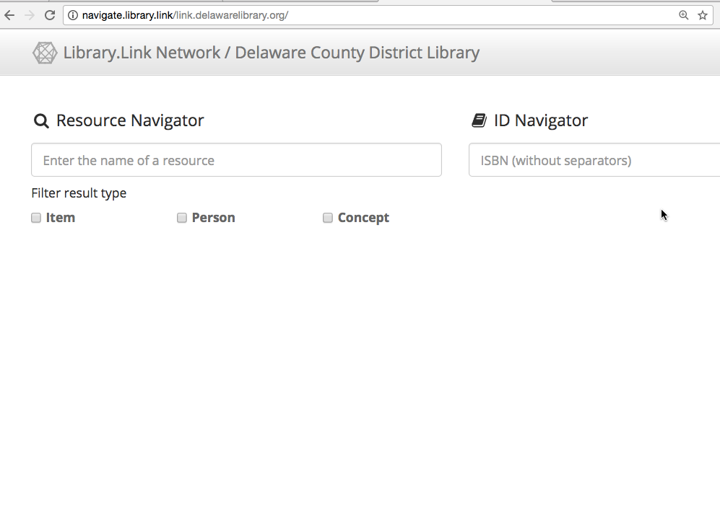
Find
Identifier
Concepts
Items
Person

Slide 14
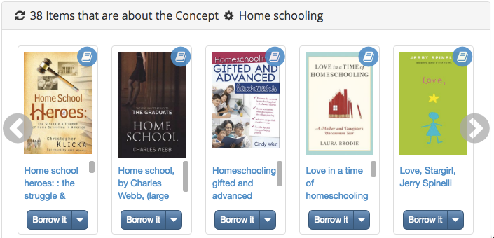
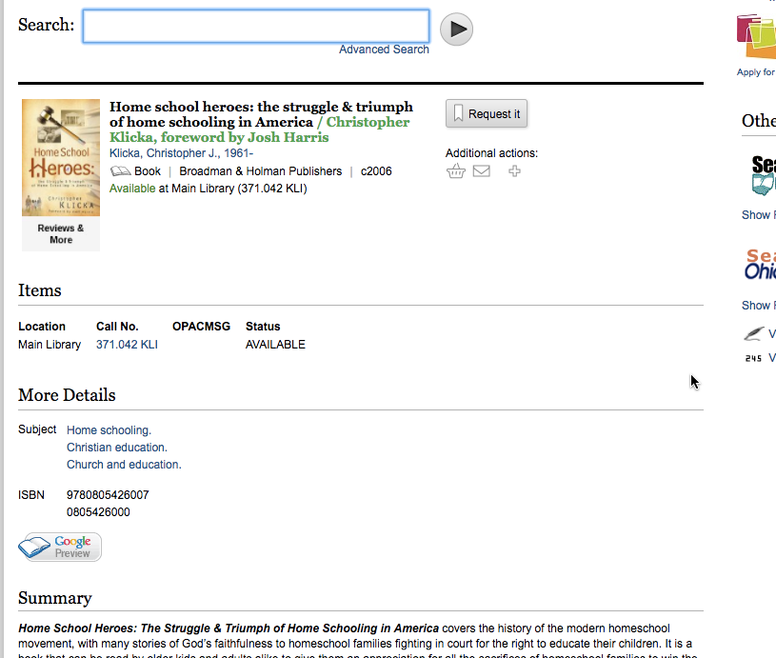
Embeddable Living Data
Use
Reflects current collection
Saves staff time
More patron connections to library content & context
Examples:
Items, Series, Concepts
New York Times Bestsellers
Connect to the Library’s Discovery & Fulfillment

Slide 15
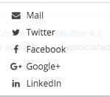
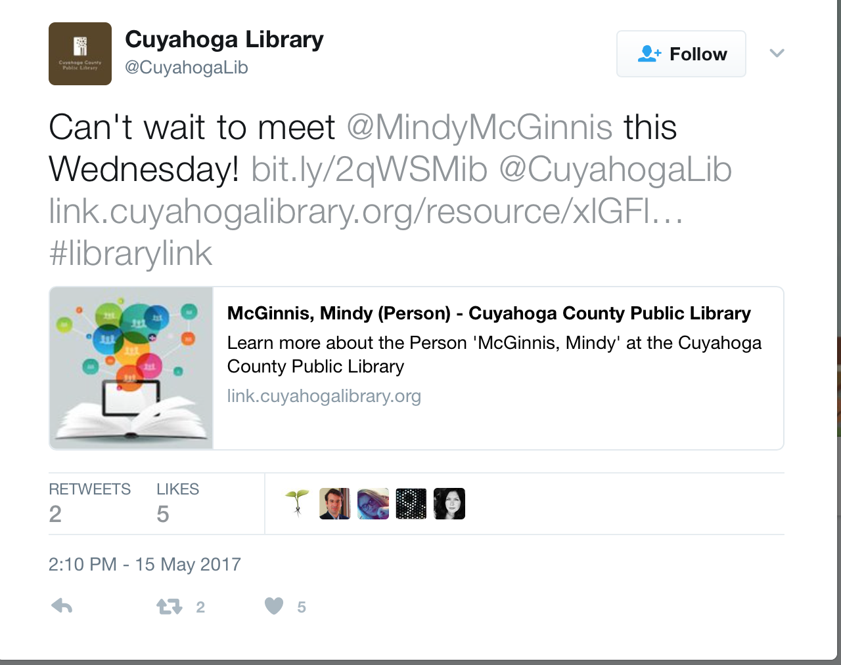
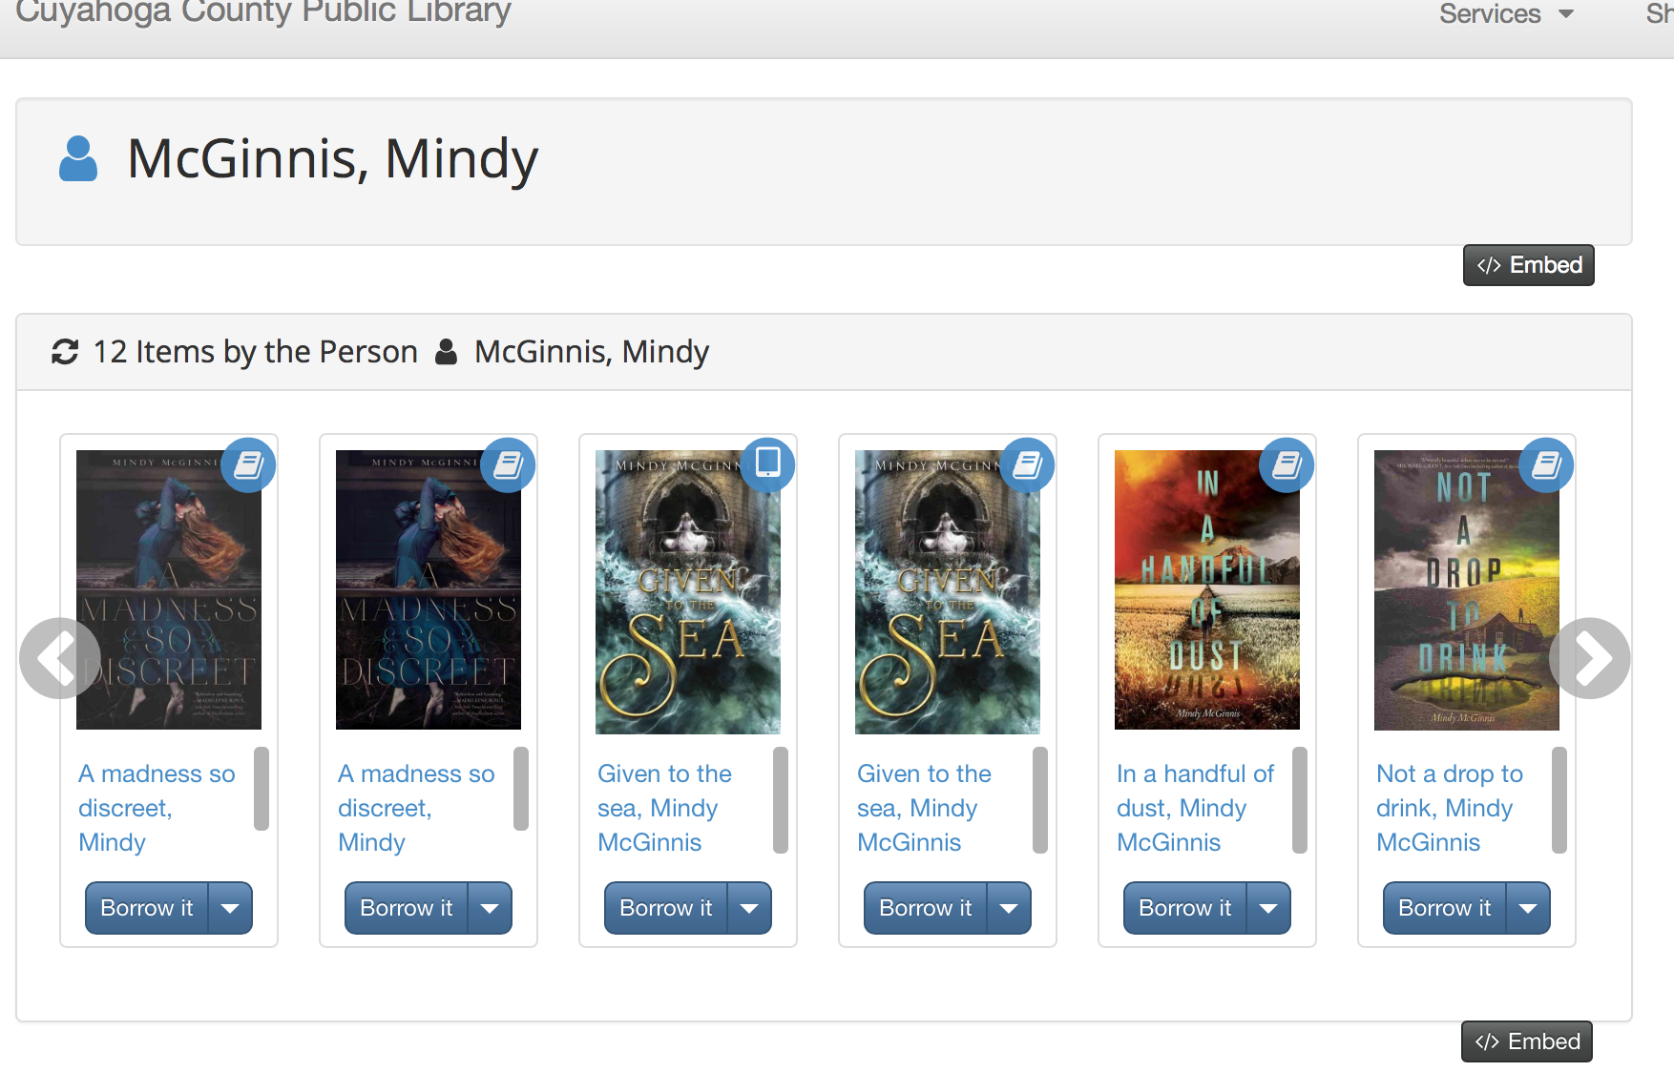

Slide 16
Logging & Statistics
Measure
Embeddable
Content
Capture statistics & inform decision making using:
Embedded content
Impression
Clicks to Library
Sharing
Impact by Channel
Full Logs available monthly for detailed analysis
Sharing

Slide 17
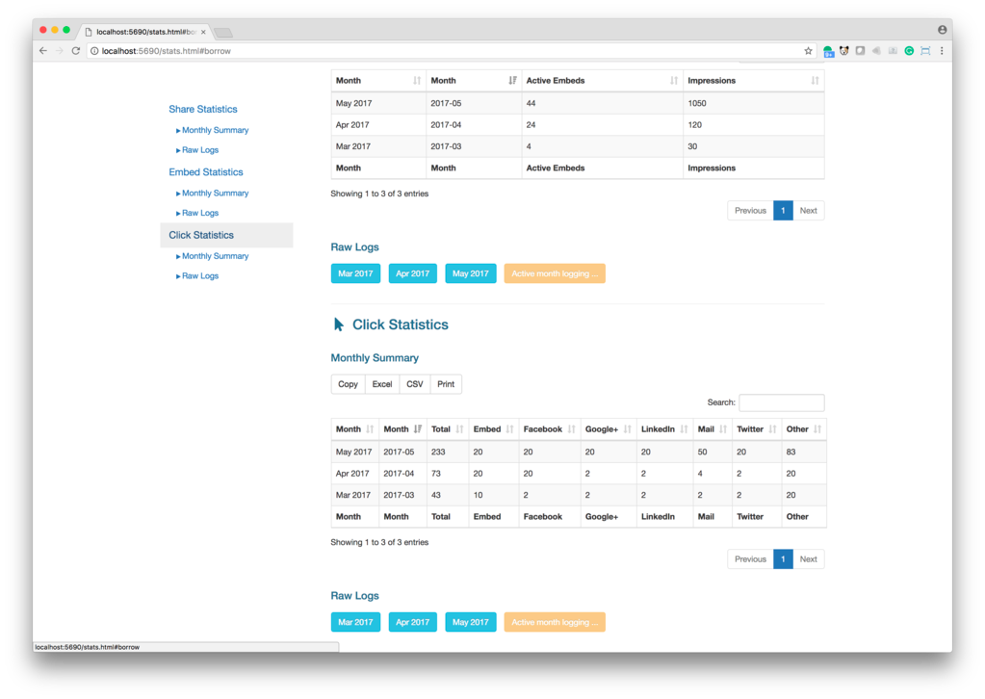

Slide 18
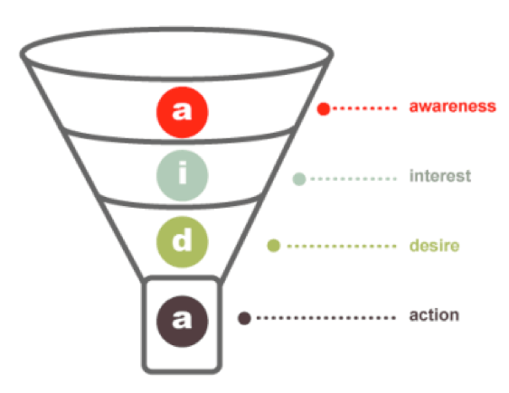
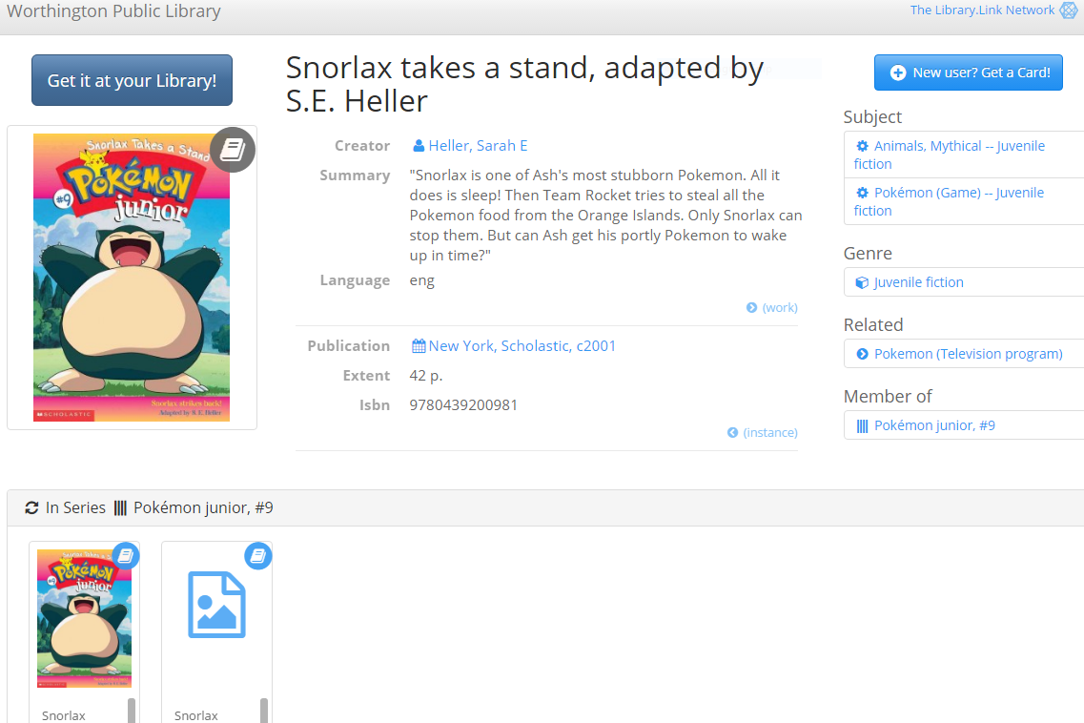
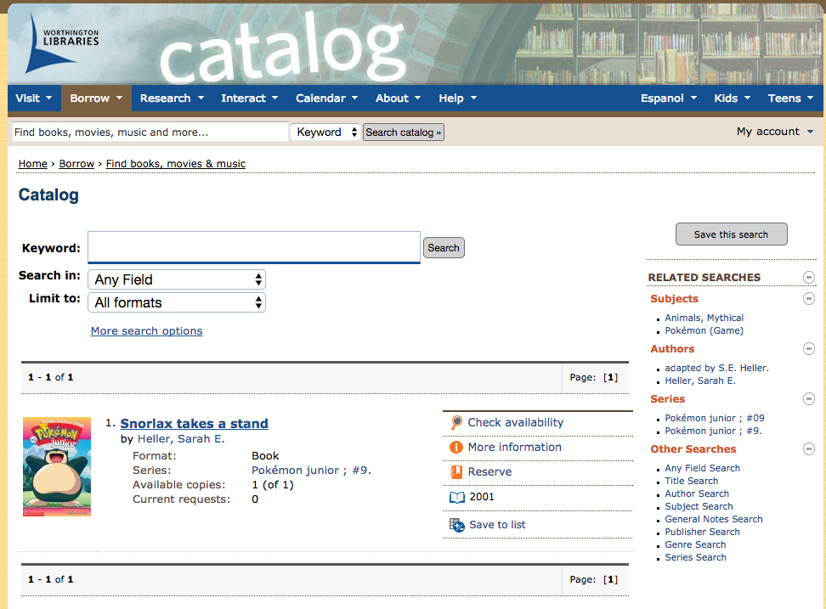
5. Accessible
Harvest
Impression
Find
Search Index
Impressions
Clicks
Use
Clicks
Library Website/
Discovery
Library
Measure
Notes:
Linked data with intent …. Locate use and measure .. Here is an example where that happens ..
Being seen is a impressions … clicking … and fulfillment ..
Linked Data with intent …. You can measure each step ..
** metaphors are missing here from my pitch
Term – multiple dimensions .. Success across multiple dimensions
**** This is something we need to speak to better …. We are going to be modeling it this way in the stats and dashboard ..*****

Slide 19
6. Contemporary and Collaborative

Slide 20
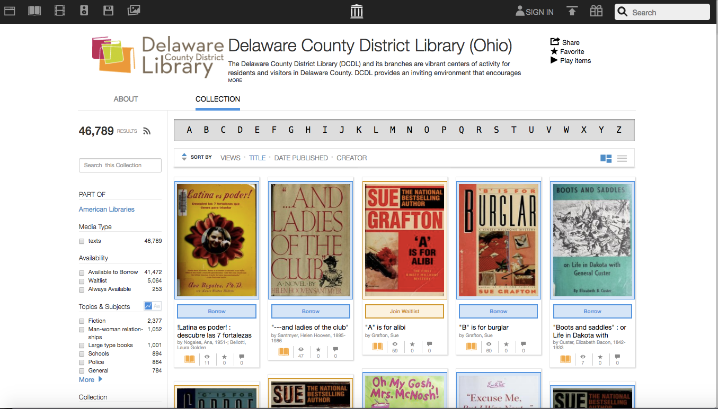
With library resources accessible via published Linked Data, the Internet Archive can provide recognized reach to new audiences.

Slide 21
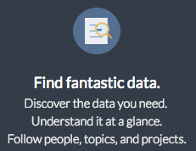
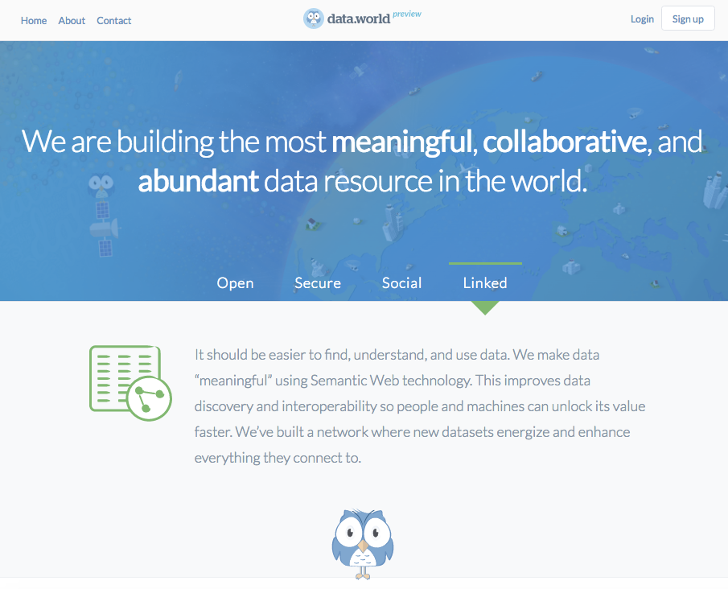
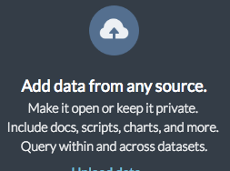
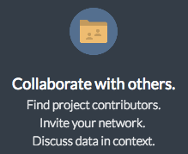
data.world delivers modern data tools and data sets for local and comparative analysis of libraries, collections, coverage, and communities.

Slide 22
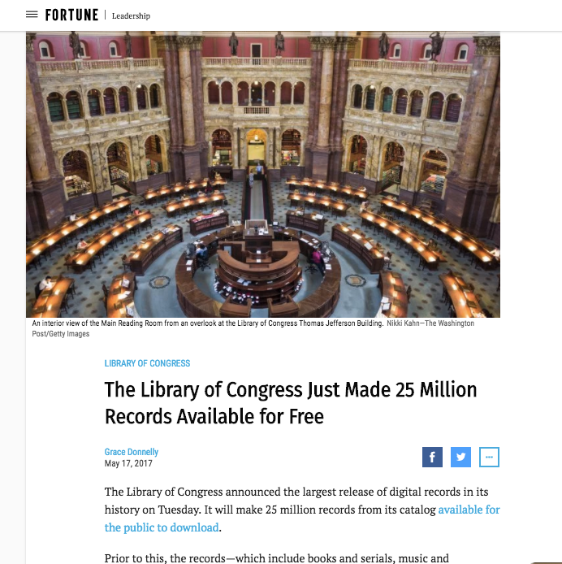
“The Library of Congress Just Made 25 Million Records Available for Free” – Fortune, May 17, 2017

Slide 23
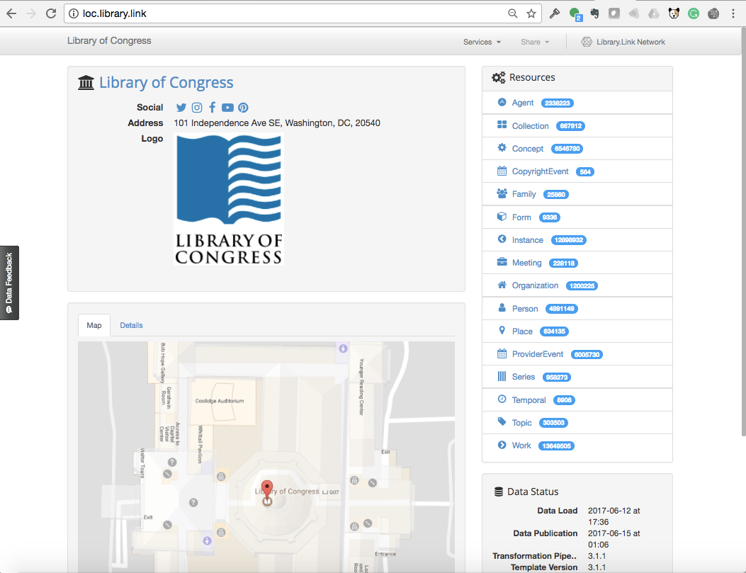
http://loc.library.link
Friday, June 23, 2017
The Library of Congress collection connects in the Library.Link Network

Slide 25
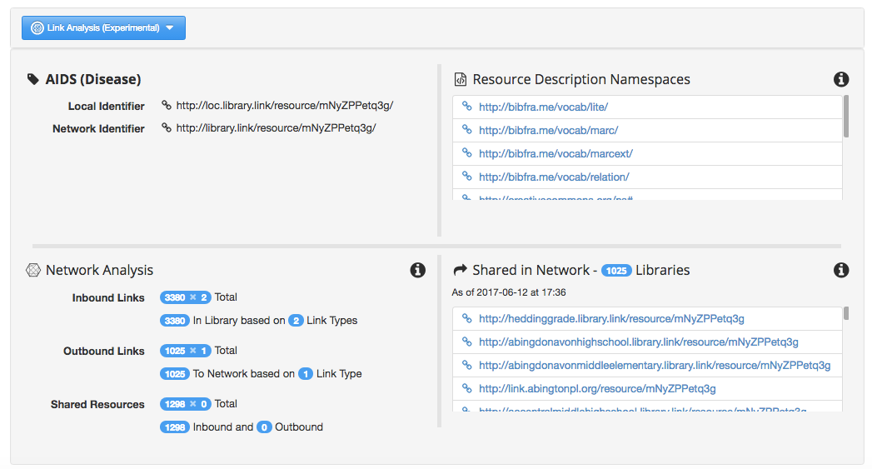
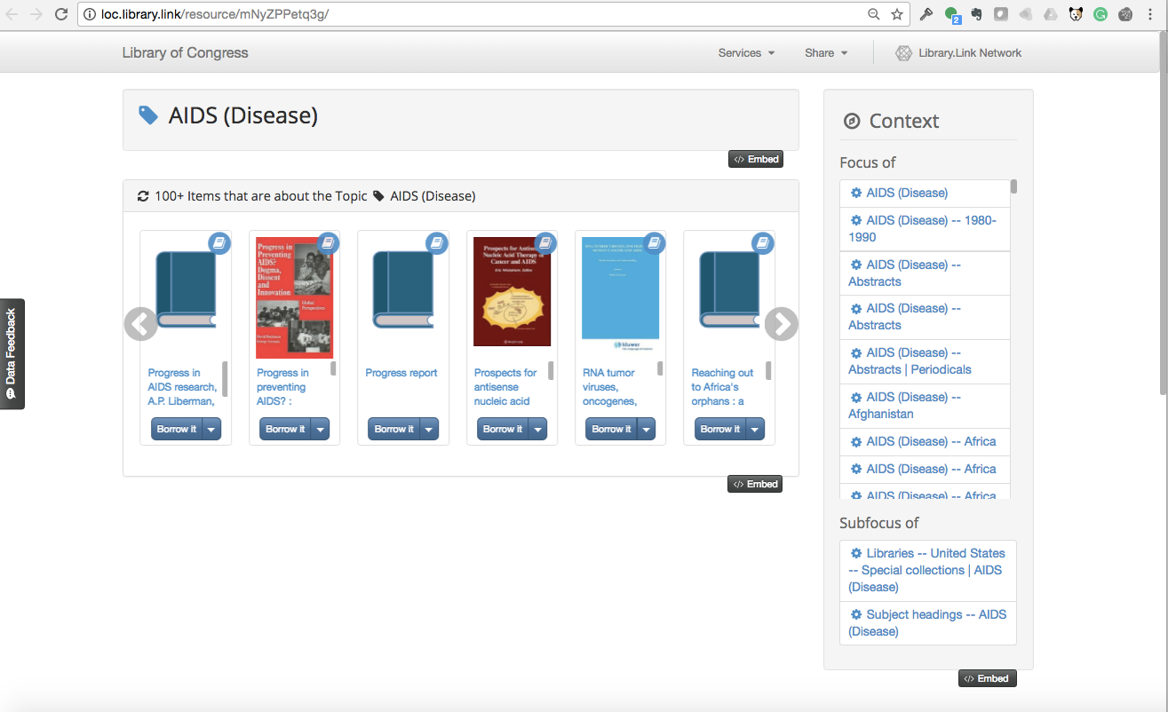

Slide 26
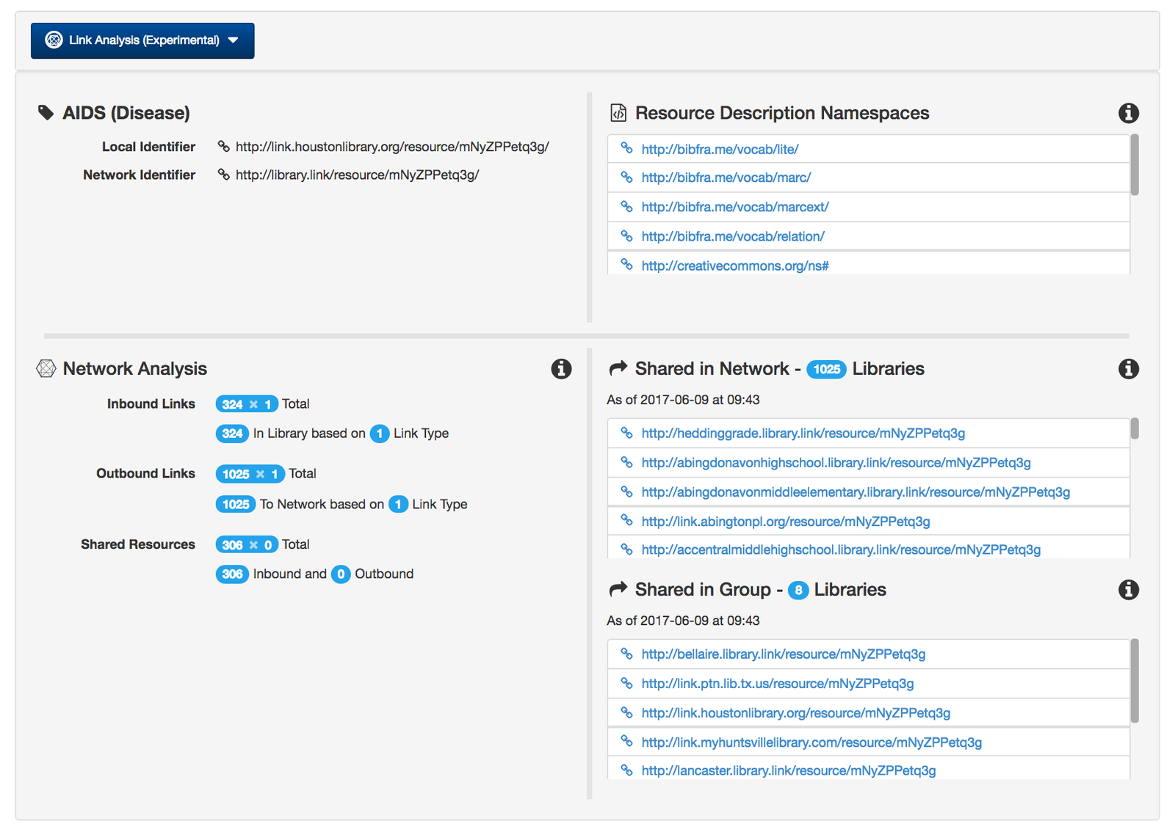

Slide 27
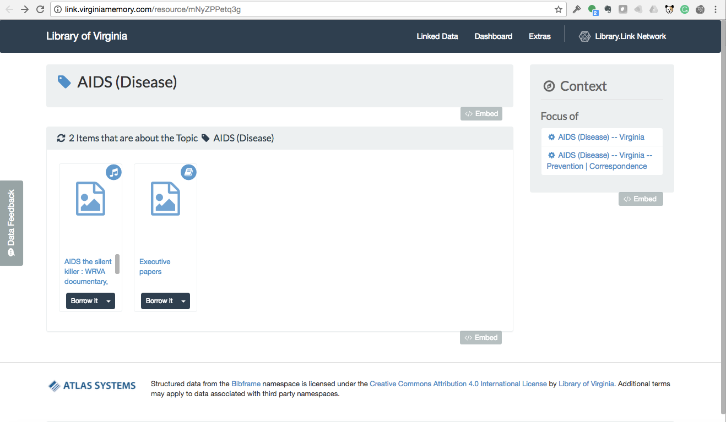

Slide 28
Becoming Data Native A Community’s Journey Together
Extensible
Purposeful
Collaborative
Connected
Accessible
Contemporary

