Slide 1
LD4P Tracer Bullet1: an RDF-based copy-cataloging pipeline
Philip E. Schreur
LC BIBFRAME Update
June 25, 2017
Notes:
Thanks for the opportunity and for coming to a program so early on a Monday morning, read title

Slide 2
Linked Data for Production
https://upload.wikimedia.org/wikipedia/commons/e/ee/Chain_link_icon.png

Slide 3
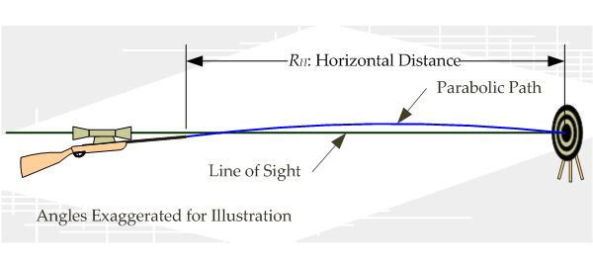
Stanford – Tracer Bullets

Slide 4
Tracer Bullet 1 Initial Workflow
Receive bibliographic records from Casalini
Autopay the Vendor via EDI
Transform MARC to BIBFRAME 2.0
Enrich the RDF with supplementary data
Discover the resource
Circulate the resource
Derive reports
Publish the data to the Web
Update the data

Slide 5
Revised Workflow

Slide 6
Workflow

Slide 7
Workflow

Slide 8
Workflow

Slide 9
Workflow

Slide 10
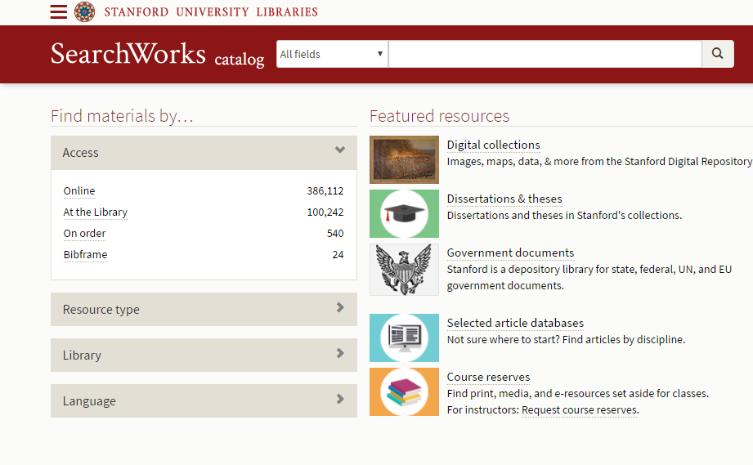
Discovery

Slide 11
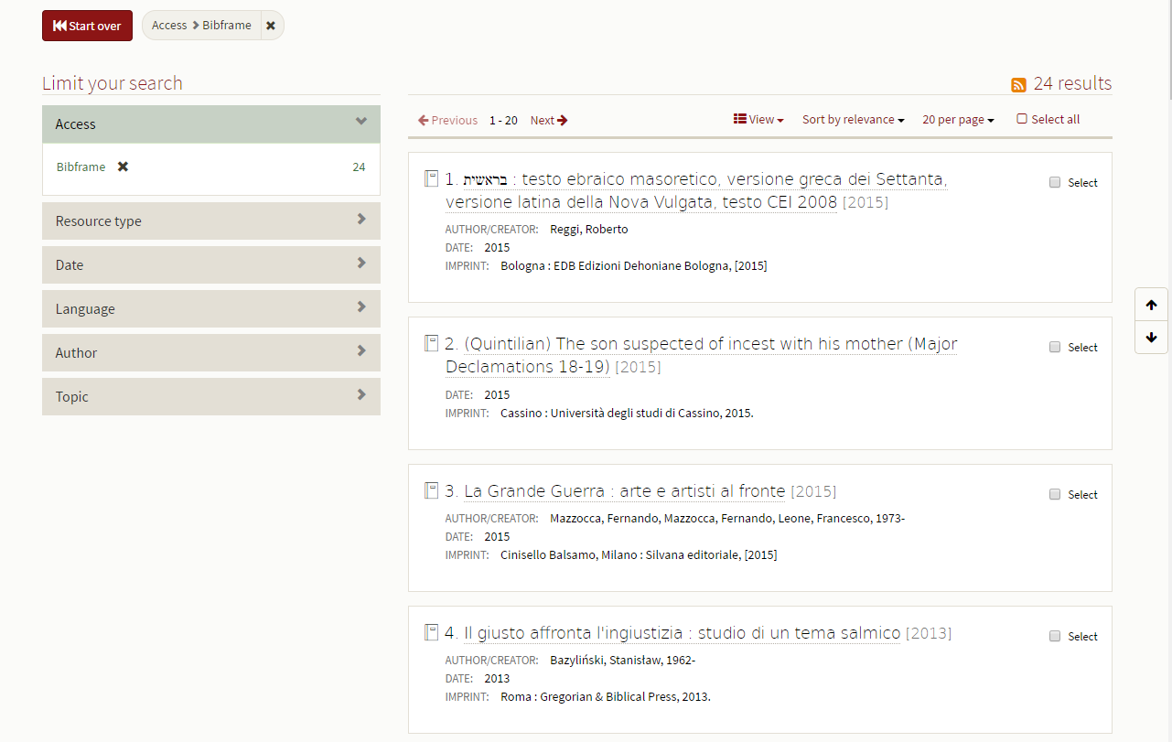
Discovery

Slide 12
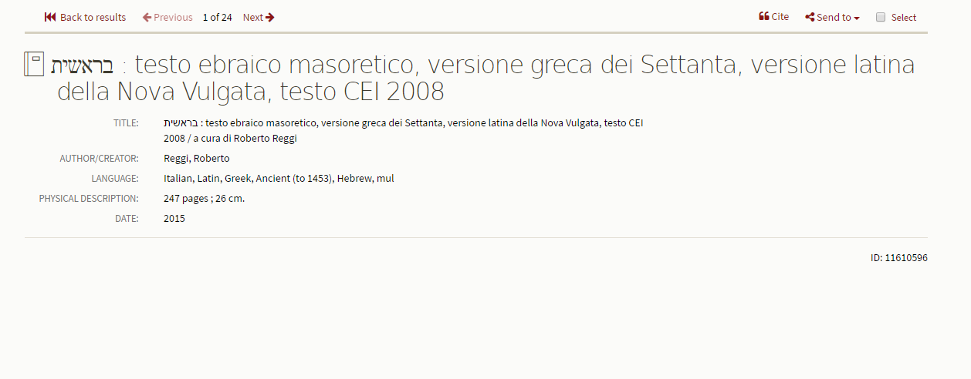
Discovery

Slide 13
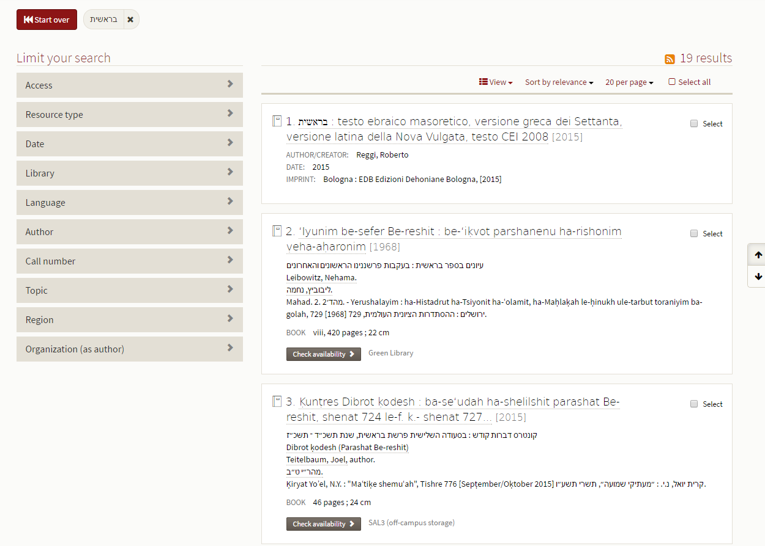
Discovery

Slide 14
Next Steps for Tracer Bullet 1
Pipeline automation
Reconciliation of our data on conversion
Updating and versioning
Sharing

