Slide 1
Library of Congress BIBFRAME Update Session. 26 June 2017
BIBFRAME and OCLC Works:
Defining models and discovering evidence
Carol Jean Godby and Diane Vizine-Goetz
Senior Research Scientists
OCLC Membership and Research

Slide 2
A starting place
OCLC researchers are acting on a request from the Library of Congress to align OCLC Works with BIBFRAME works.
We are working in the larger context of two Program for Cooperative Cataloging Task Groups: PCC-Work, and PCC-URI.
Notes:
The PCC-Work TF is doing a comparative analysis of the Work models being developed in the library community and writing up the results in a white paper. BIBFRAME and OCLC Works are among them. Others: FRBR, RDA, and IFLA’s Library Reference Data Model.
The PCC-URI TF is defining best practices for

Slide 3
One highlight….
OCLC’s linked-data models reflect what can be discovered in aggregations of data converted from MARC.
This outcome is congruent with BIBFRAME and other efforts in the library community to specify a future in which library data is more machine-understandable than it is today.
Notes:
In other words, OCLC is pursuing a data-driven approach to modeling. That is the theme I want to develop today, with respect to our “work on Works.” This is a companion to the presentation that my OCLC colleague Roy Tennant gave six months ago, at the Midwinter LC BIBFRAME Update session.

Slide 4
MARC Uniform Title Record cluster
VIAF
VIAF Work
VIAF Expression
VIAF “Extended Relationship” (xR) record
“same”
Work cluster
records
Research prototypes
MARC bibliographic records
WorldCat Works
Inputs
Model outputs
Visible outputs
Notes:
Like BIBFRAME, OCLC’s Works are discovered in two resources: MARC bibliographic and Uniform Title authority records. In general, Authority records produce VIAF Works and bibliographic records produce OCLC works. Traditionally, they have been processed in separate projects, but they’re obviously related. There is a VIAF Work for William Faulkner’s book “Go Down Moses.” And there is a WorldCat Work. Since they describe the same thing, they’re “the same” in some respect.
Our previous presentation focused on VIAF Works, and here we will drill down into OCLC Works. In short: a Work is a cluster of bibliographic descriptions that have the same author, title, genre, and resource type, according to algorithms working directly on the data. The raw output is simply a cluster of MARC records (shown in the middle of the slide). Downstream processes (shown in the right-hand segment of the slide) create 1) the hierarchical display of search results on WorldCat; 2) research prototypes such as Classify and Cookbook Finder; 3) and the RDF dataset known as WorldCat Works.
Broadly speaking, the process that starts with bibliographic records (WorldCat) is more complex than the VIAF process. But there is some overlap. For example, VIAF records sometimes show ‘xR’ as a source authority. That’s an ‘Extended Relationship’ record. An xR record is a synthetic uniform title record created from a WorldCat Work cluster. It is an experimental attempt to increase the number of uniform title records because we all know there aren’t enough of them. In our data, only a small number of WorldCat Work clusters contain bib records with references to uniform title authority records.

Slide 5
Relationships to bibframe
Notes:
This section describes some of the tangible outputs of the process for creating Works from bibliographic records and compares them to BIBFRAME Works.

Slide 6
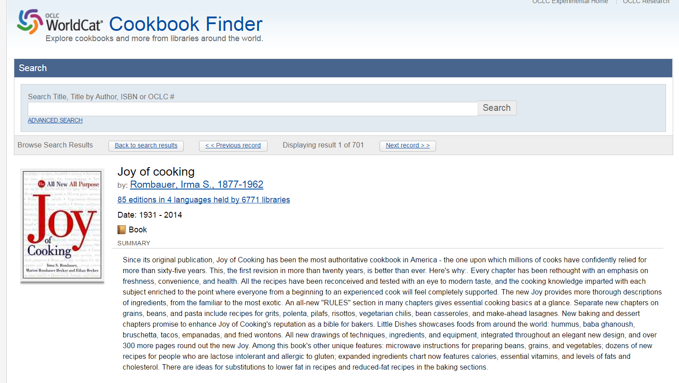
Notes:
With this background, we can get started. I’ll show a bit more about the applications derived from the model outputs.
WorldCat Cookbook Finder is a research prototype. It builds a user experience for browsing and searching bibliographic records organized as Works and other FRBR Group I categories. One of the inputs is the set of Work clusters. The result is a human-readable description of the properties that describe the content of Works such as Irma Rombauer’s Joy of Cooking. Shown here: author, description, date range for published editions.

Slide 7
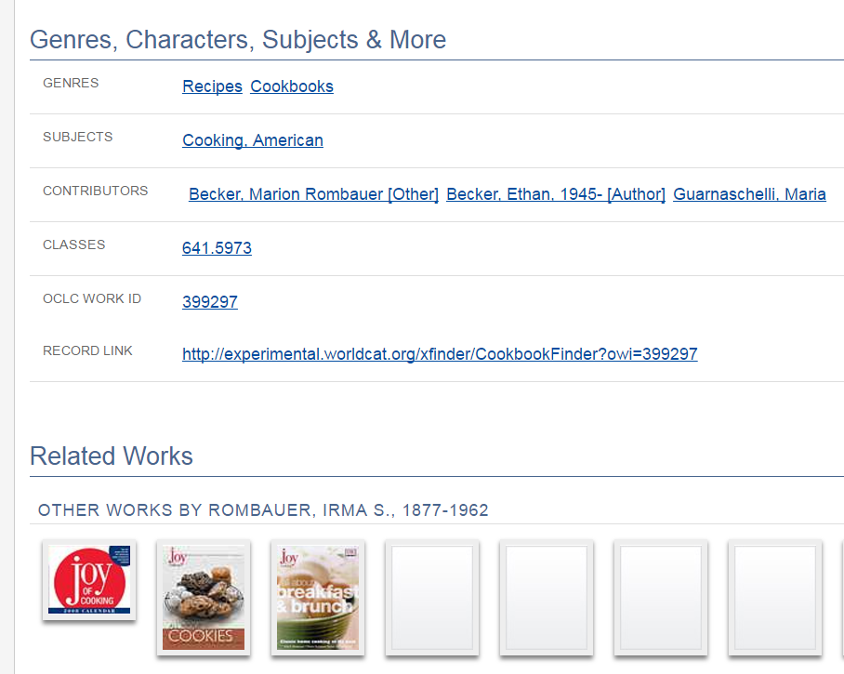
Notes:
Authors, subjects, class assignment.
Again: Joy of Cooking is not built on linked data, but is an application derived from the same source, the cluster of MARC records that we call Works. Note the Work identifier, which is associated with the Work cluster.

Slide 8
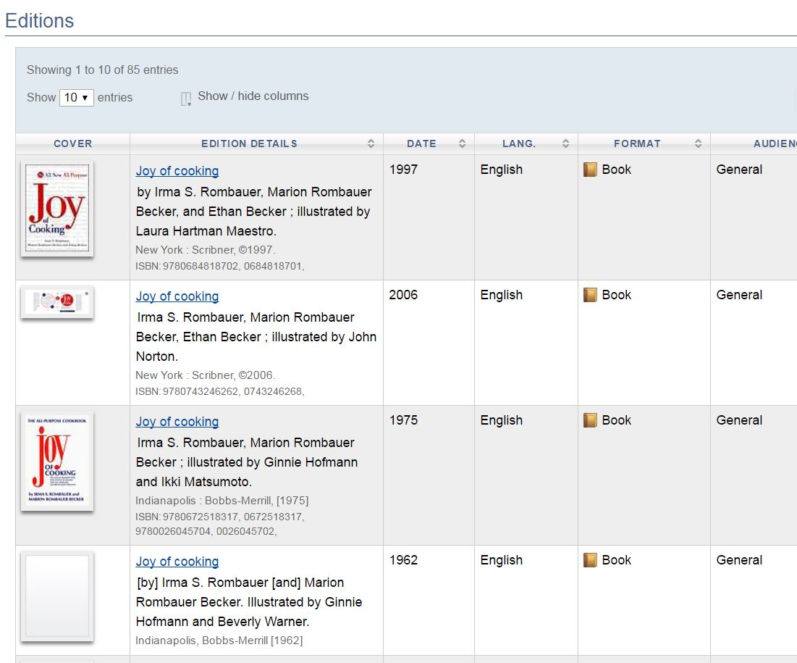
Notes:
Links to editions, or Manifestations. OCLC’s holdings are another input.

Slide 9
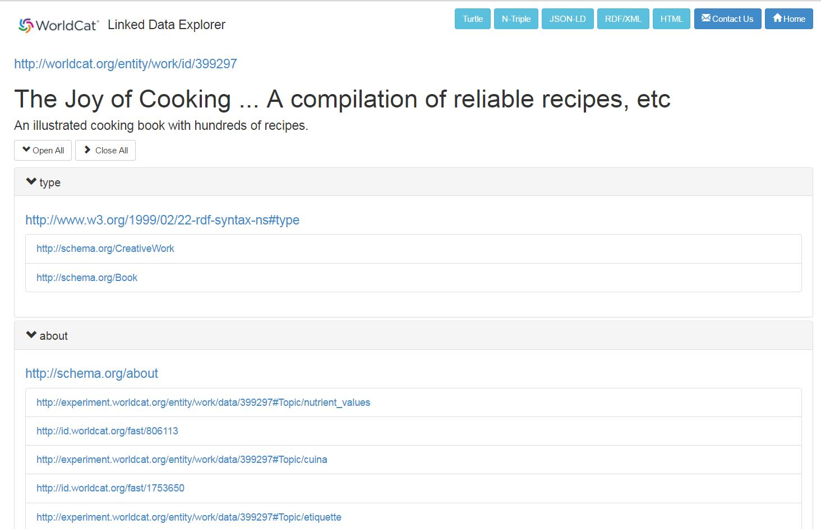
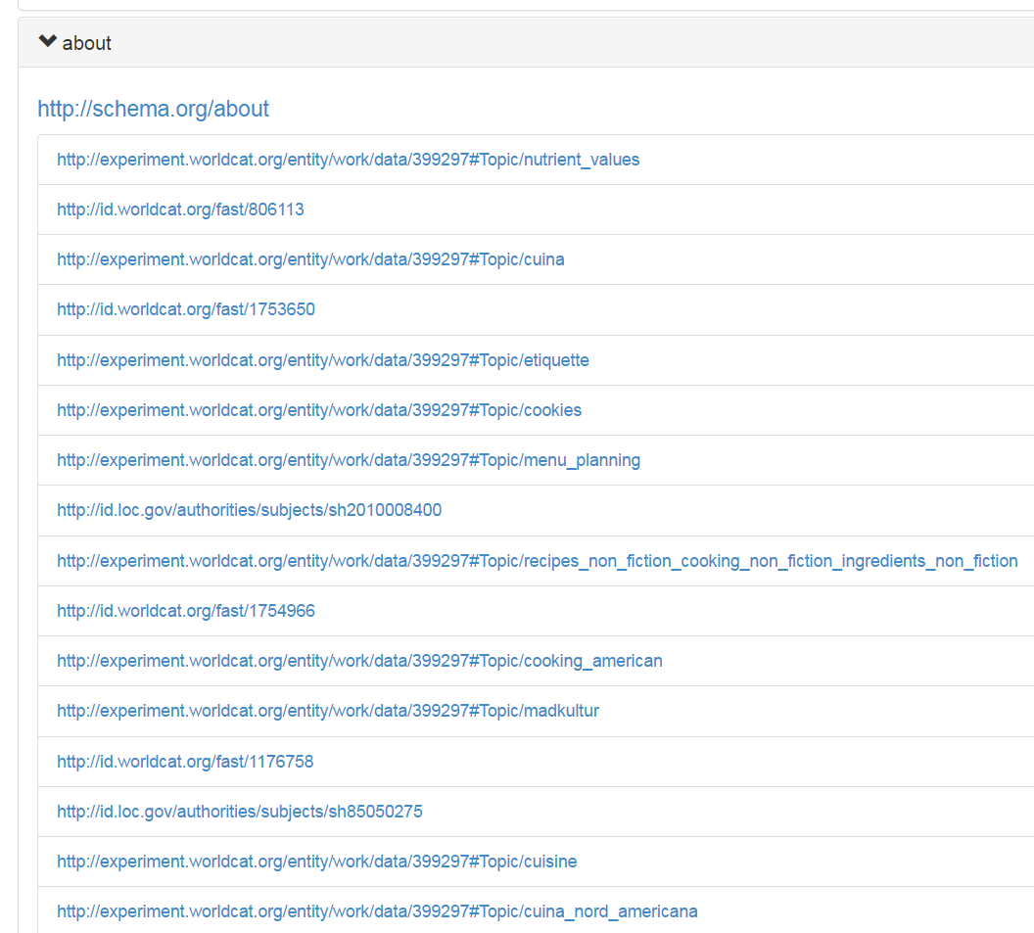
Notes:
Here is the corresponding WorldCat Linked data description derived from the same source. The Work ID is the same the one shown in Cookbook Finder: 399397.
This is the raw data, designed for machine understanding. It can be delivered via Web protocols shown in the turquoise tabs across the top: HTML, JSON-LD, RDF XML, etc.
Cookbook Finder filters the raw data for a clean user experience. For example it displays the most popular subject (Cooking, American). The complete list excerpted here.
Because WorldCat Works is agnostic about how it might be used and is expressed as Linked Data, this is the typical point of comparison with BIBFRAME Works.

Slide 10
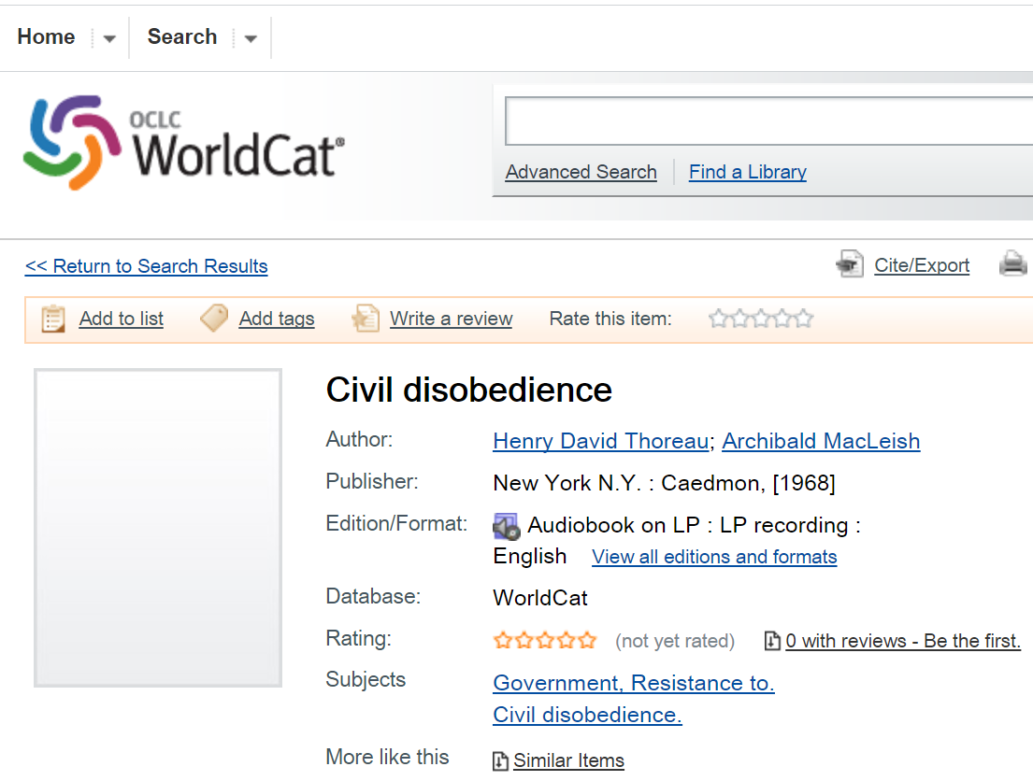
Notes:
The next set of slides shows links to WorldCat Works in WorldCat catalog records and compares them to corresponding BIBFRAME descriptions. This is an example from the a dataset in the BIBFRAME 2.0 converter distribution. It describes an audiobook of Thoreau’s Civil Disobedience narrated by Archibald MacLeish published by Caedmon in 1968.

Slide 11
Title
Main Title: “Civil disobedience”
Contribution
Agent: <Henry David Thoreau>
Role: <aut>
Subject: <civil disobedience>
Genre Form: <sound recording>
Credits: “Read by Archibald McLeish”
BF Work
OCLC Work
exampleOfWork
Audio Issue Number: “TC 1263”
Provision Activity Statement:
Agent: Caedmon
Place: <New York, N.Y>
Date: “1968”
Dimensions: “12 in.”
BF Instance
Notes:
Applying the BIBFRAME converter to this record produces two outputs:
The Work, containing subject-level information very similar to the output of OCLC’s processes. The data in blue is shorthand for data represented as URIs, not text strings. We have URIs for Henry David Thoreau playing the role of author, and for subject headings and genres. LC is also investigating the possibility of extracting information about Works from MARC linking fields and $t subfields. This is also consistent with what OCLC is doing.
Instance, describing this edition of Civil Disobedience, with publication information and a product identifier.
In progress: BF Work descriptions are being built out in two ways: 1) aggregated in clusters. 2) associated with instances and items. This is similar to OCLC’s approach, though we place more emphasis on automated processes.
At the bottom of the Worldcat.org page is OCLC’s Linked Data representation of this MARC record. It contains many details seen in BIBFRAME output. It contains a URI to a WorldCat Works description, which resolves to a cluster of records. In other words, the 1968 audiobook edition of Civil Disobedience is only one member of the Work cluster.
In the long run: BF and OCLC Works are aiming for the same goal. Achieved with similar strategies. A reduction step – extract work-level information; 2) an aggregation step – create a composite description.

Slide 12
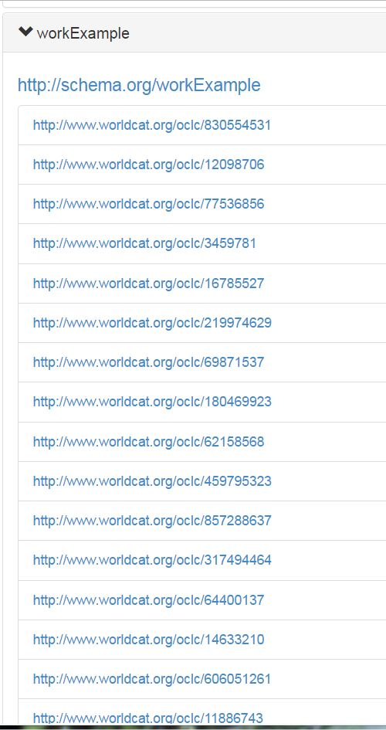
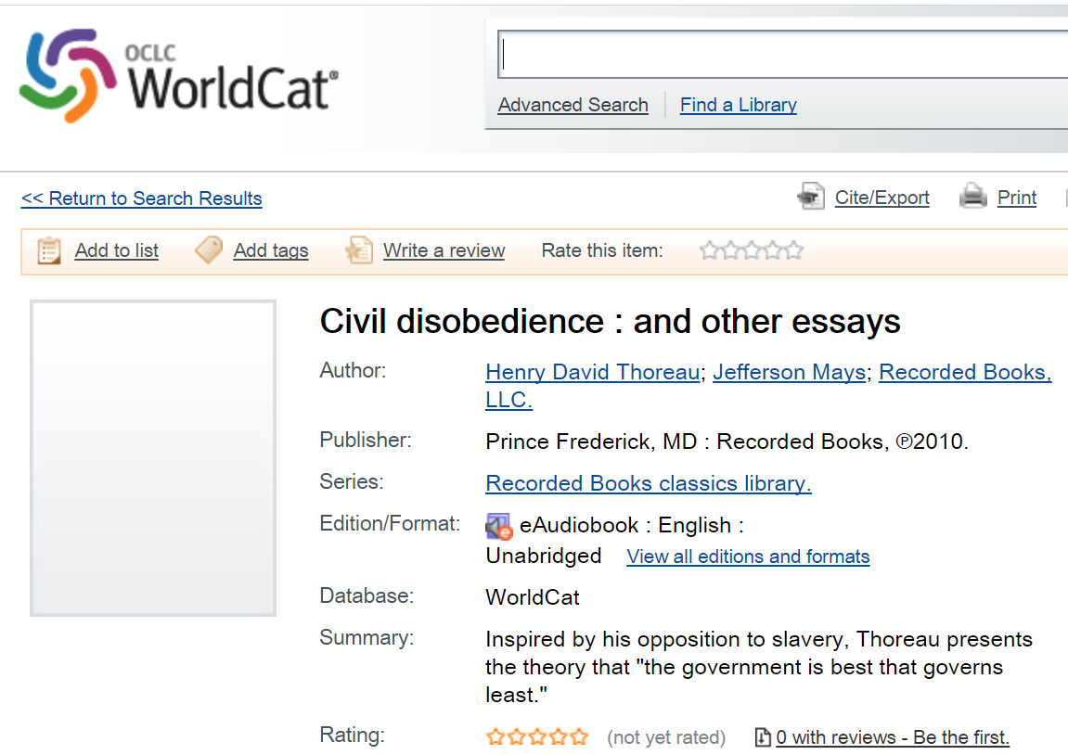
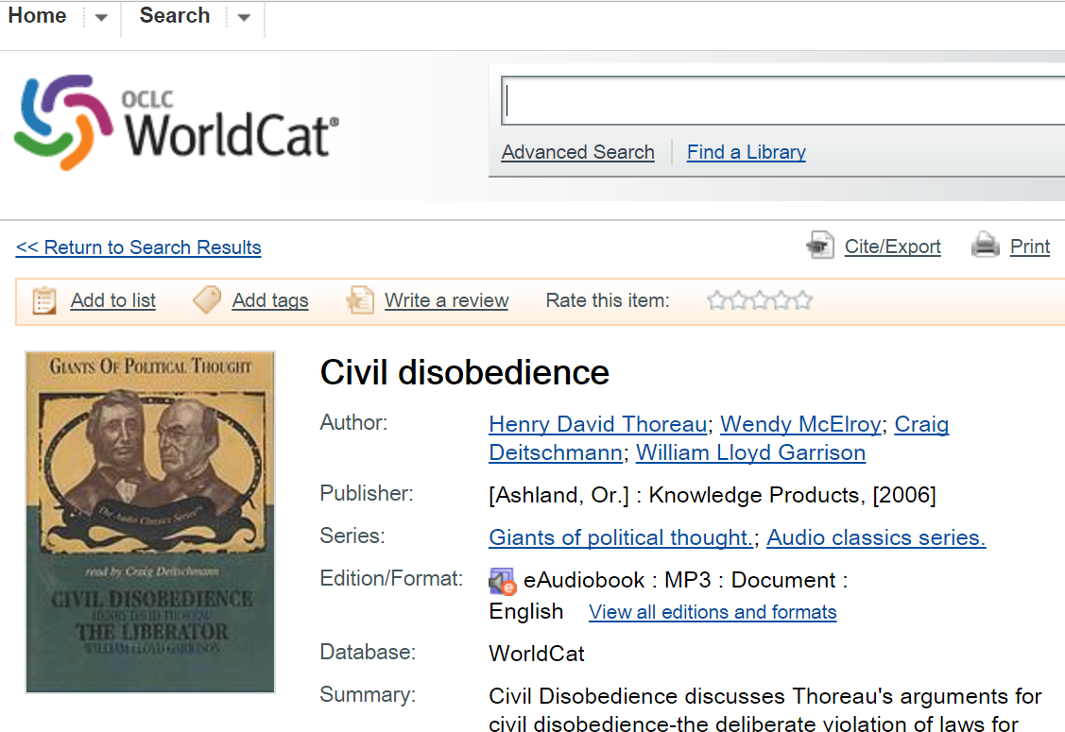
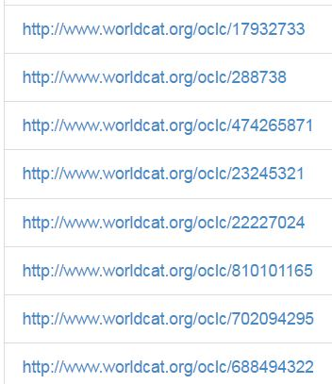
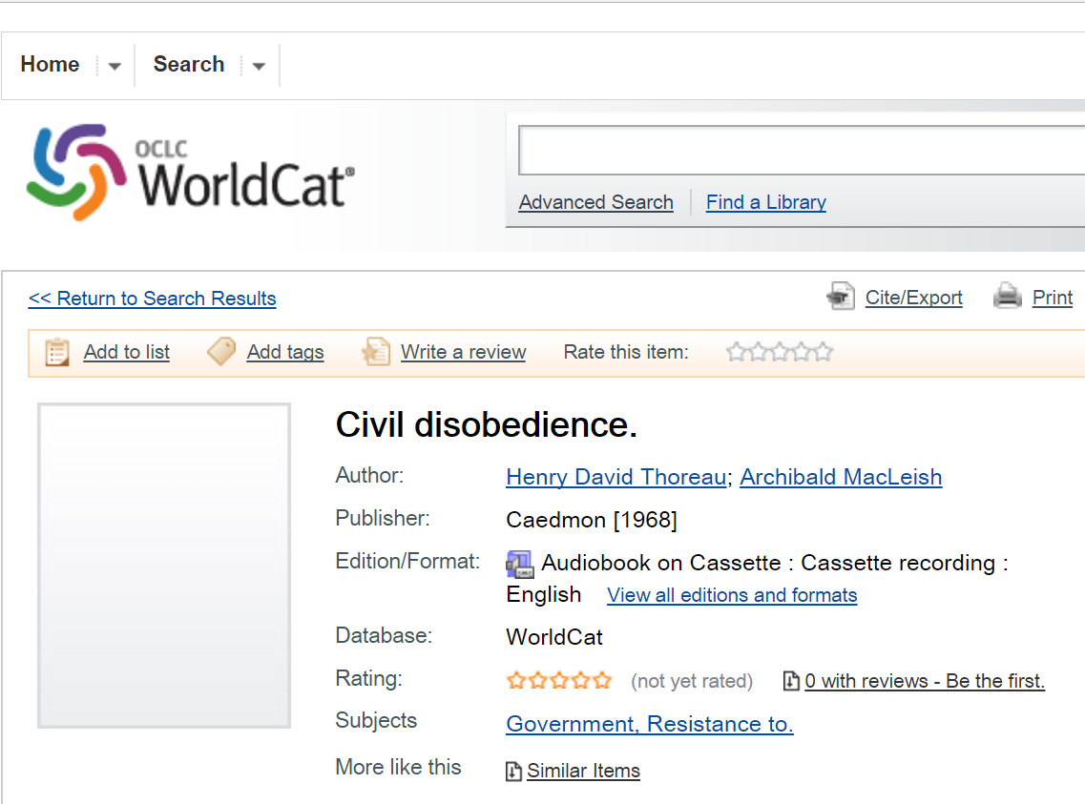
23 descriptions of sound recordings, with different:
Publishers
Issue dates
Carriers
Narrators
Notes:
The raw data looks like this, and is just another WorldCat Works page. But when the ‘example of work’ links are dereferenced, the other members of the cluster are retrieved. Three are shown here. (Summary points)
Note that an aggregate is included in the cluster. This is obviously an error, but it occurs because it is difficult for a machine process to detect aggregates with certainty. I’ll return to this point later.

Slide 13
OCLC Works and LC records
WorldCat
LC subset
394,835,538 records
78% (178,375,018) are singleton works
Non-singleton work clusters average 4.18 records
230,113,951 total works
10,321,873 records
26% (2,706,494) are singleton works
Non-singleton work clusters containing LC records average 7.74 records
9,575,077 total works
Notes:
Extracted records from WorldCat with DLC in subfields $a and/or $c of MARC 040 Cataloging Source
For example, 040##$aDLC$cDLC indicates cataloging produced and input by the Library of Congress
10,321,873 records

Slide 14
Don Quixote in WorldCat Works
260 LC records with Uniform title: Don Quixote*
247 records for books
104 LC records in primary Don Quixote work cluster (~7900 WorldCat records)
79 singleton works
64 records in 21 additional clusters; includes translations not [yet] recognized by the clustering algorithms and other works
Notes:
Examples of singleton works
Primera y segvnda parte del ingenioso hidalgo Don Qvixote de la Mancha
Don Quixote de la Mancha : an old-spelling control edition based on the first editions of parts 1 and 2 / prepared by R.M. Flores
Examples: in additional clusters
El ingenioso hidalgo Don Quijote de la Mancha / Miguel de Cervantes ; ilustraciones de José Ramón Sánchez ; edición, introducción y notas de Angel Basanta ; apéndices de Eduardo Pérez-Rasilla [and others].
Don Quixote of the Mancha / retold by Judge Parry ; and illustrated by Walter Crane

Slide 15
The “Work” in context
Notes:
Now that we’ve gone through a couple of examples, I’d like to step back and put WorldCat and BIBFRAME Works in the context of FRBR and related models.

Slide 16
FRBR | BIBFRAME | OCLC
Work. “A distinct intellectual or artistic creation” | Work. “The highest level of abstraction…reflects the conceptual essence of the cataloged resource: authors, languages, and what it is about (subjects).” | Author, title, format; content properties such as subject or genre
Expression. “A Work realized as a distinct intellectual or artistic form” |  | A language tag or evidence of a translation relationship
Manifestation. “Physical embodiment of an Expression” | Instance. “…one or more individual embodiments of a Work” | A product code, such as an ISBN
Item. “Exemplar of a Manifestation” | Item. “…an actual copy of an Instance.” | Evidence of uniqueness
Notes:
FRBR, BIBFRAME (and other models such as RDA and IFLA’s Library reference model) are specifications.
Roughly speaking: BIBFRAME and the OCLC model of Works represent a simplification of the FRBR model because only three levels are clearly distinguished: Work, Manifestation, and Item. The distinction between Work and Expression is only a soft one.
But the color change in the slide is meant to suggest that OCLC’s model of Works is different from the two other model specifications shown here. OCLC’s model does not propose new definitions but is simply a list of the criteria we use to discover categories in MARC data defined by FRBR.
The results are expressed in Schema.org for two reasons:
We can’t be sure that they’re exactly the same as FRBR because empirical reality only approximates theory.
But if what we do discover is expressed in a general-purpose vocabulary, other users outside the library community are in a better position to consume it.

Slide 17
FRBR in the OCLC model of Works
“Work”
schema:CreativeWork
Creative Work with a “language” descriptor or a translator
“Expression”
schema:CreativeWork
“Manifestation””
Creative Work with
a “Product” identifier
exampleOfWork
schema:CreativeWork
schema:ProductModel
workExample
“Item”
Creative Work with a “Uniqueness” identifier
schema:CreativeWork
schema:IndividualProduct
Notes:
A graphical representation of the OCLC’s rules for identifying FRBR categories in slightly more technical detail. Bottom line: FRBR Group I categories can be expressed, in a lightweight fashion. They are all labeled (or “typed”) as creative works and are labeled as “examples” of the category above them in the hierarchy.
There are three Schema.org type assignments corresponding to the three categories that can be distinguished. As we move down the hierarchy, the description becomes more and more specific. At the top are Work and Expression. If this description also has a Product identifier such as an ISBN, it is labeled as a Manifestation. If the description also has a barcode or other uniqueness identifier, it is labeled as an Item.
The relationships between the levels are generic. The same relationships can be used at all levels. ExampleOfWork points up (relating an Expression to a Work). WorkExample points down (relating an Expression to a Manifestation).
The properties are defined in schema.org: “workExample: Example/instance/realization/derivation of the concept of this creative work.” Note that the definition is a cover term for the relationships spelled out in the FRBR definitions.

Slide 18
Alignment with BIBFRAME
BIBFRAME Work
OCLC Work
workExample / bf:translation
workExample / workTranslation
es
OCLC Expression
OCLC Expression
en
lang
lang
workExample
bf:instanceOf
BIBFRAME Instance
OCLC Manifestation
workExample
bf:itemOf
BIBFRAME Item
exampleOfWork
OCLC Item
Notes:
This diagram is like the one that was described in our previous presentation at ALA Midwinter, but it has more detail. It’s just another way of emphasizing the points of similarity between the OCLC model of Work and BIBFRAME.
The OCLC model and BIBFRAME both recognize Work, Manifestation, and Item categories.
Where there is evidence, as in the Translation relationship, a category interpreted as an Expression can also be identified.
The relationships are generic. If more information is available, a more specific “workTranslation” relationship can be expressed (and its converse).
BIBFRAME is similar. OCLC has one general relation; BF has two (itemOf/instanceOf). The BF relations can also be upgraded to something more specific (translation/translationOf … etc).

Slide 19
Synergies

Slide 20
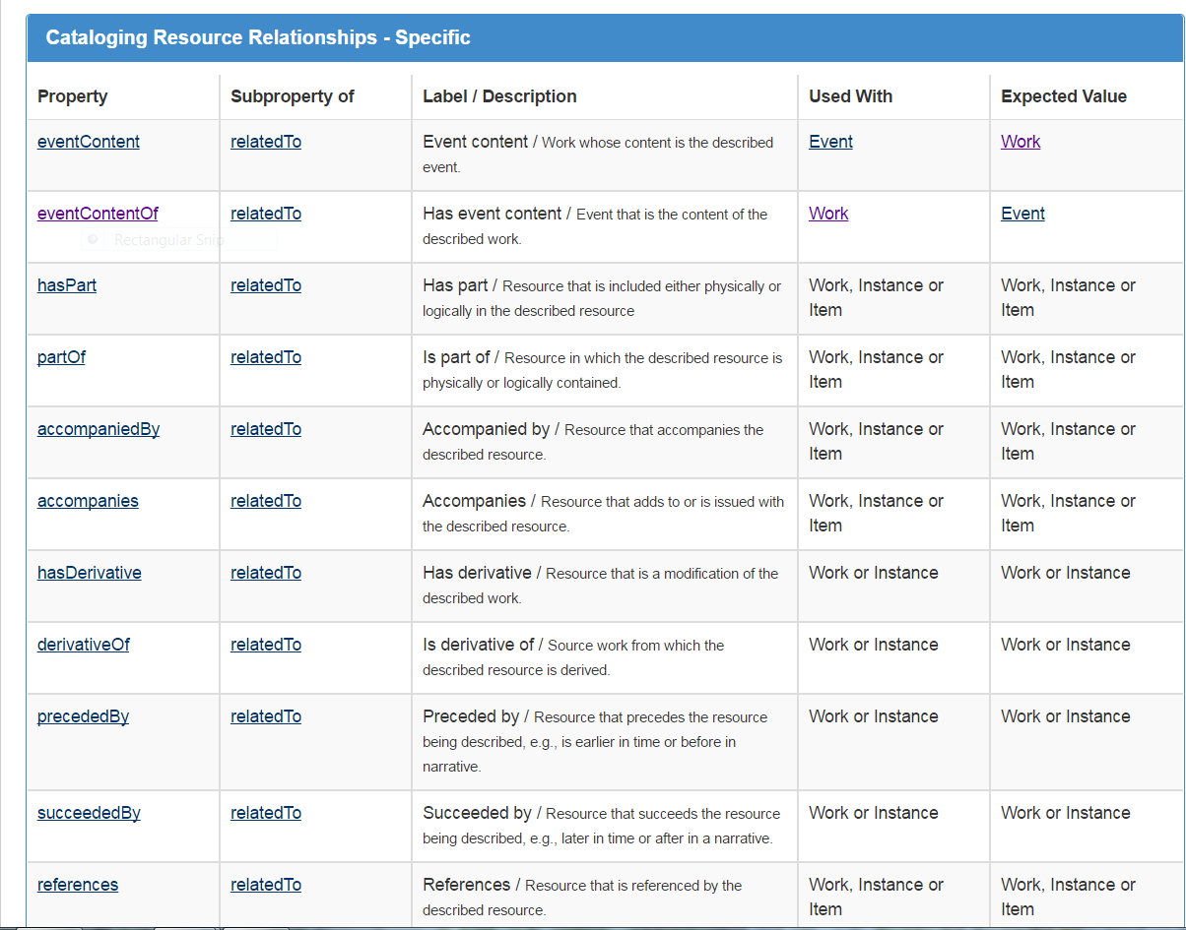
hasPart, partOf
accompaniedBy, accompanies
hasDerivative, derivativeOf
precedes, precededBy
Notes:
I have hinted several times that the “Translation” relationship is important in OCLC’s model of Works. Karen Smith-Yoshimura’s presentation in the Linked Data roundtable covers this point in more detail.
Translations are inherently important, of course, but in our data-driven approach to FRBR, translations represent the best evidence for the Expression concept, and for a Work-to-Expression relationship.
But other relationships have obviously been defined, particularly in the RDA Relationship ontology. And BIBFRAME 2.0 has incorporated many of these relationships, into an ontology that specifies the type of relationship. For example, HasPart and accompaniedBy are examples of the “relatedTo” relationship.

Slide 21
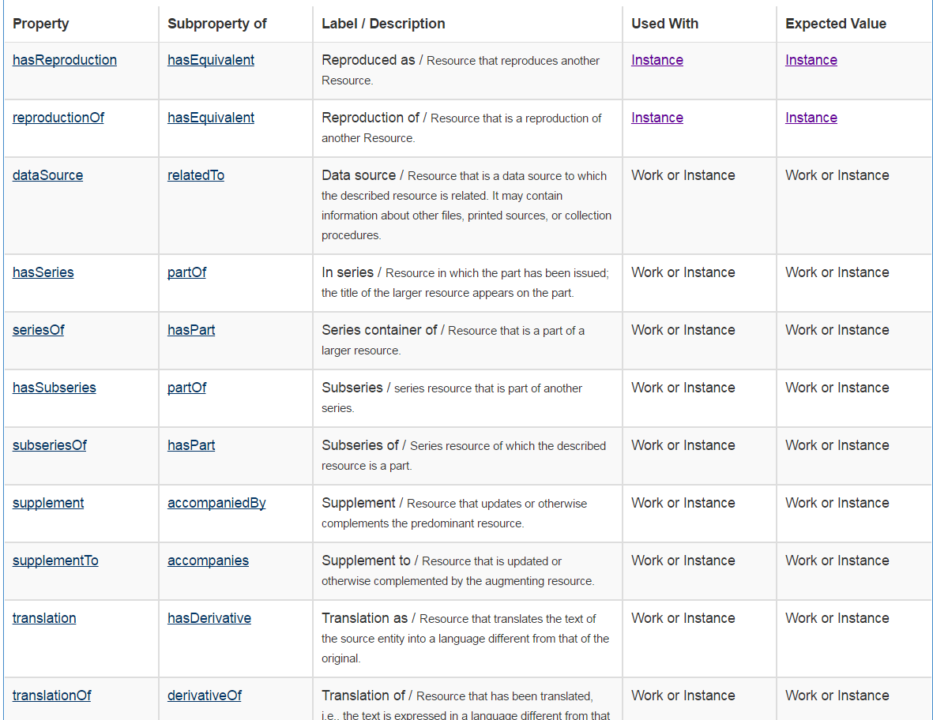
Notes:
And more relations…hasReproduction, dataSource…
Translations are a type of “Derivative” relationship between Works and Instances. The relationship and the things related are very close to what we would say.
In the future, we will attempt to discover some of these other relationships. For example, we mentioned earlier that some types of aggregates create errors in our Work clusters.
Thus, the creation of original descriptions that includes these relationships such as BIBFRAME would represent a major step forward toward our community’s goal of upgrading MARC and creating a model of our domain that is more machine-understandable.
In other words, bibliographic descriptions that reference BIBFRAME relationships would make it easier to do what OCLC is trying to do: aggregate the world’s descriptions of library resources to improve the connection between users to the information they seek, and provide a backbone to the library operations that support this goal.

Slide 22
Why OCLC’s “work on Works” is in synch with BIBFRAME
We’re describing the same things.
Our goal is to discover evidence for standards, not propose new ones.
We agree that Works are fundamentally important in the domain of library resource description.

Slide 23
Jean Godby
OCLC Membership and Research
godby@oclc.org

Slide 24
For more information
Jean Godby. 2016. A Division of Labor. In Linked Data for Cultural Heritage (Ed Jones and Michele Seikel, eds). ALCTS monograph.
PCC SCS/LDAC Task Group on the Work Entity.
PCC Task Group on URIs in MARC.
Karen Smith-Yoshimura. 2017. Representing Translations as Linked Data. OCLC Linked Data Roundtable. ALA Annual.
Roy Tennant and Jean Godby. 2017, OCLC’s Work on Works. ALA Midwinter.
WorldCat Cookbook Finder.

